Slide 1
STACK USING LINKED LIST
Mr. Yogesh Sharma
Assistant Professor
CSE, MAIT

Slide 2
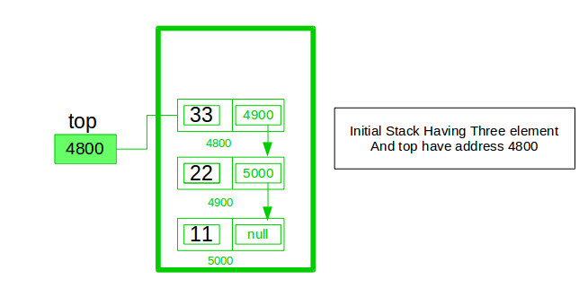

Slide 3
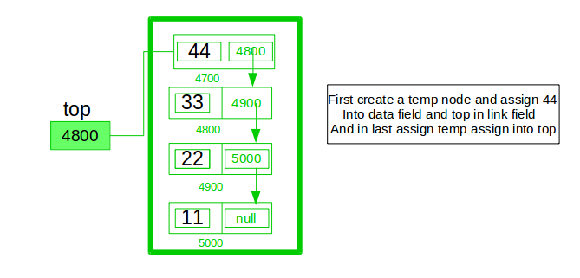

Slide 4
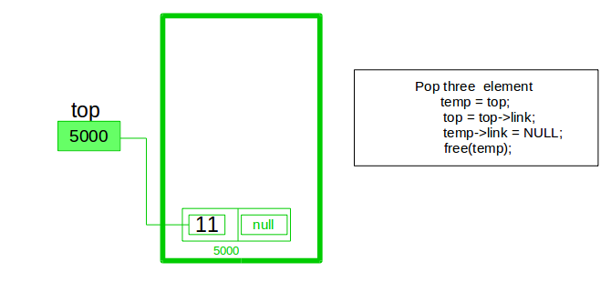

Slide 5
PUSHING THE ELEMENT
void push(int value)
{
struct Node *newNode;
newNode = (struct Node*)malloc(sizeof(struct Node));
newNode->data = value;
if(top == NULL)
newNode->next = NULL;
else
newNode->next = top;
top = newNode;
printf("\nInsertion is Success!!!\n");
}

Slide 6
POPING THE ELEMENT
void pop()
{
if(top == NULL)
printf("\nStack is Empty!!!\n");
else{
struct Node *temp = top;
printf("\nDeleted element: %d", temp->data);
top = temp->next;
free(temp);
}
}

Slide 7
DSIPLAY THE CONTENT
void display()
{
if(top == NULL)
printf("\nStack is Empty!!!\n");
else{
struct Node *temp = top;
while(temp->next != NULL){
printf("%d--->",temp->data);
temp = temp -> next;
}
printf("%d--->NULL",temp->data);
}
}

Slide 8
static void reverse(struct Node** head_ref)
{
struct Node* prev = NULL;
struct Node* current = *head_ref;
struct Node* next = NULL;
while (current != NULL) {
// Store next
next = current->next;
// Reverse current node's pointer
current->next = prev;
// Move pointers one position ahead.
prev = current;
current = next;
}
*head_ref = prev;
}

